Slide 1


Forging
The Future
OUR STRATEGY | 2022-2025
www.scottish-fencing.com
#ForgingTheFuture

Slide 2


Scottish Fencing
Our Strategy | 2022 - 2025
#ForgingTheFuture
Introduction and Evolution
IT HAS BEEN 3 YEARS SINCE WE DELIVERED THE FIRST
ITERATION OF OUR #FORGINGTHEFUTURE STRATEGY.
When we launched in 2018, this was a new direction and a key objective was to place strong pathways at the heart of everything we do.
Whilst this hasn’t changed, we are keen to acknowledge the
opportunities which the future present, which includes harnessing the power of sport to play a key role in the health of the Nation, reduce inequalities and of course make Fencing in Scotland a community where people feel truly at home.
#ForgingTheFuture

Slide 3

Scottish Fencing
Our Strategy | 2022 - 2025
Our Vision,
Mission & Values
#ForgingTheFuture

Slide 4



Scottish Fencing
Our Strategy | 2022 - 2025
Vision
#ForgingTheFuture
Mission
To create an inclusive sporting community
where the power of fencing drives social change
#ForgingTheFuture

Slide 5
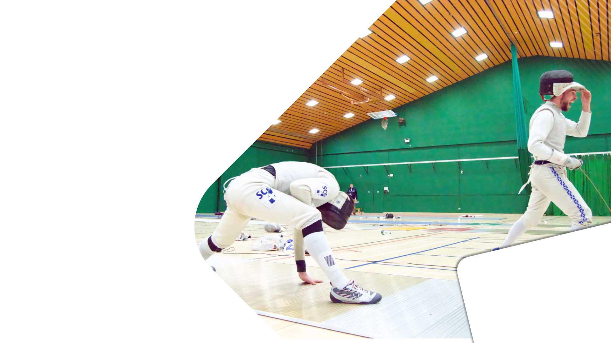
Scottish Fencing
Our Strategy | 2022 - 2025
Who We Are:
Our Core Values
PEOPLE
INCLUSION
COLLABORATION
CURIOSITY
#ForgingTheFuture

Slide 6


Scottish Fencing
Our Strategy | 2022 - 2025
Who We Are:
Our Core Values
PEOPLE
We value people
and their development
We want to encourage those who support and inspire others and are positive in their actions.
#ForgingTheFuture

Slide 7

Scottish Fencing
Our Strategy | 2022 - 2025
Who We Are:
Our Core Values
INCLUSION
Fencing is inclusive
With a focus on constantly developing, we’re learning to be inclusive and will work with those who share our commitment to inclusion.
#ForgingTheFuture

Slide 8

Scottish Fencing
Our Strategy | 2022 - 2025
Who We Are:
Our Core Values
COLLABORATION
We collaborate to innovate
Members, partners and supporters are the keys to progress. We hold their success as our success.
#ForgingTheFuture

Slide 9

Scottish Fencing
Our Strategy | 2022 - 2025
Who We Are:
Our Core Values
CURIOSITY
We are curious,
not judgemental
We value anyone who can contribute to Fencing and we don’t have all the answers.
#ForgingTheFuture

Slide 10
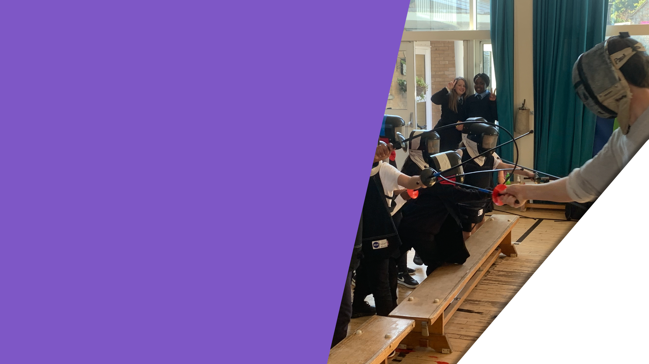
Scottish Fencing
Our Strategy | 2022 - 2025
Our Objectives And
How We Plan To Get There
#ForgingTheFuture

Slide 11



Scottish Fencing
Our Strategy | 2022 - 2025
Communities
OBJECTIVE
A network of resilient fencing communities with strong links to local partners.
STRATEGIES
By 2025, ensure fencing communities are seen as investable community impact organisations offering a unique experience.
#ForgingTheFuture

Slide 12


Scottish Fencing
Our Strategy | 2022 - 2025
Communities
TACTICS / PROJECTS
YEAR 3
Maintain G&W Growth Objectives – share learning
with UK bodies and other sports
to maintain connective tissues
of fencing as a vehicle for
positive change
Maintain SIMD Member Gain Objectives begin delivery of free Active Schools sessions (could be achieved earlier if government commitments are met)
Established Methodology
for Community/Club Growth –
FCDM begins building
next phase with SF staff/communities/members
Begin Evolution of Next Strategic Phase…
YEAR 1
Recruit Fencing Community Development Manager (FCDM)
Increase G&W* Participation – specific 3-year programme to increase G&W participation in the sport and our communities
SIMD** Member Gain – targeted 3-year programme to regain those members lost to sport during the pandemic
Club/Community Prioritisation – specific support available for those clubs who wish to play a role in presenting a fencing club/community
Activation of West Region Action Plan for sustainable growth
Establish Formal Competition Management Group – internally driven – specific support available for those clubs
YEAR 2
Maintain G&W Growth Objectives – expand to
1 other community/club area
Maintain SIMD Member Gain Objectives – expand to 1 other community/club area
Maintain the West Region Action Plan – interweaving with club/community programmes
Build Ever-Closer Links with Active School Delivery as part of Scot Gov commitment to free active schools sessions
*Girls & Women
**Scottish Index of Multiple Deprivations
#ForgingTheFuture

Slide 13

Scottish Fencing
Our Strategy | 2022 - 2025
Social Change
OBJECTIVE
A purposeful presence for fencing in communities.
STRATEGIES
Through intentional behaviour, support our communities to overcome barriers to participation in Scotland.
#ForgingTheFuture

Slide 14

Scottish Fencing
Our Strategy | 2022 - 2025
Social Change
TACTICS / PROJECTS
YEAR 1
Specify which communities SF will target for impact projects
Develop and document the SF Changing Lives methodology
Provide club/community-specific support to upskill clubs and widen their participation base through different entry points and forms of Fencing
Develop an “Accessible Club” framework for communities/clubs to follow SF #ChangingLives Coach Education programme
Build cross-sport collaboration to “go deep” in a small number
of targeted communities
YEAR 2
Increase number of targeted communities by 1
Maintain SF #ChangingLives Coach Education Programme
Maintain cross-sport collaboration
Develop & share stories of club/community success
YEAR 3
Increase number of targeted communities by 1
Maintain SF #ChangingLives Coach Education Programme
Begin Evolution of Next Strategic Phase…
#ForgingTheFuture

Slide 15

Scottish Fencing
Our Strategy | 2022 - 2025
Inclusion
OBJECTIVE
Ensure every fencing community can be a
home for anyone.
STRATEGIES
Deliver on the equality action plan by 2023
& recruit a key role to transform the club & community environment.
#ForgingTheFuture

Slide 16

Scottish Fencing
Our Strategy | 2022 - 2025
Inclusion
TACTICS / PROJECTS
YEAR 3
Submit application for next stage of equality standard
Increase number of G&W inclusion projects by 1
Increase number of SIMD inclusion projects by 1
Begin Evolution of Next Strategic Phase…
YEAR 2
Maintain commitment
to attainment of the
Equality Standard
Increase number of G&W inclusion projects by 1
Increase number of SIMD inclusion projects by 1
YEAR 1
Recruit a Fencing Community Development Manager
Maintain rollout of SF Equality Action Plan
for attainment of equality status
Targeted inclusion awareness activities with particular focus on increasing the number of Girls & Women and Participants from SIMD backgrounds –
2 projects (female coach educators has been identified as one of the projects)
*Girls & Women
**Scottish Index of Multiple Deprivations
#ForgingTheFuture

Slide 17



Scottish Fencing
Our Strategy | 2022 - 2025
People Development
OBJECTIVE
A growth journey for every member of the fencing community.
STRATEGIES
Provide education & support to develop a progressive fencing volunteer workforce across Scotland.
#ForgingTheFuture

Slide 18
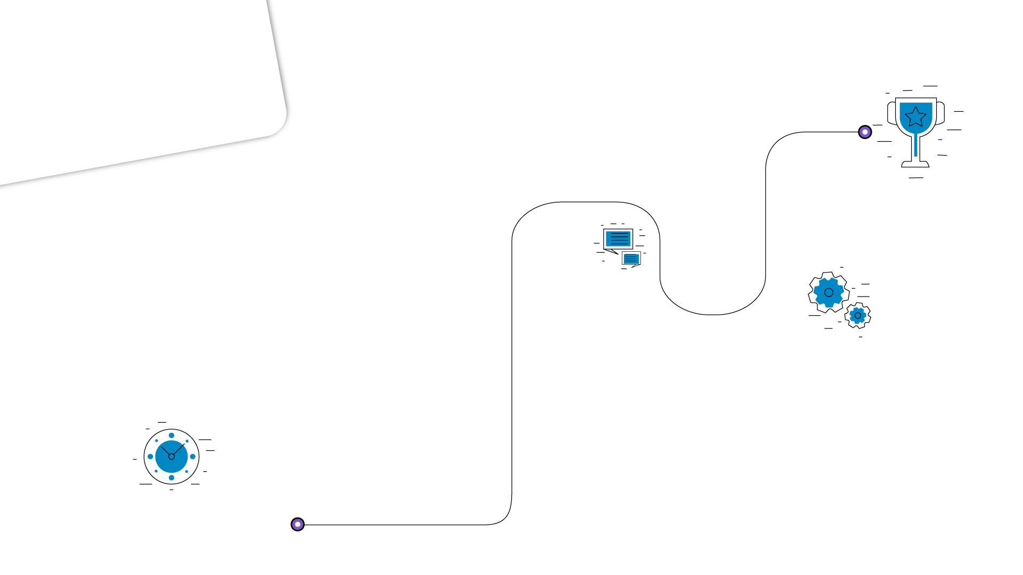

Scottish Fencing
Our Strategy | 2022 - 2025
People Development
TACTICS / PROJECTS
YEAR 3
Maintenance of People Development Strategy & Plan
YEAR 1
Create a multi-year People Development strategy focusing on the following:
• Collaborative & Inclusive pathways - workforce, athletes, volunteers
• Education Focus - this is more than just a sport, we must have a partnership focus
• Safeguarding in Sport - Every fencing community is a safe place for all
• Refreshed & Agile Communications Strategy - tell more stories, help people grow
SCC*/CIMSPA** Release (by end of year 1 – we are likely to
tender for a partner to deliver this)
More Coaches – at all levels with varying focus – participation,
inclusion, changing lives, performance
2022 EnGarde Intro award for absolute beginners
Scottish Fencing in-person coaching conference
with Fencing Partners, volunteers & other partners
YEAR 2
“Better People make Better Refs - Better People make Better Athletes – Better People Make Better Coaches”
Community/Club Workforce Development:
2023 SCQF*** Level 5 Coaching award
2024 SCQF Level 7 Intermediate Coaching Award
Referees – Specified education twice yearly
Athletes – Emerging Athletes Development Programme delivered within SF Pathways
*Scottish Coaching Certificate
**Chartered Institute for the Management of Sport & Physical Activity
***Scottish Credit & Qualifications Framework
#ForgingTheFuture

Slide 19
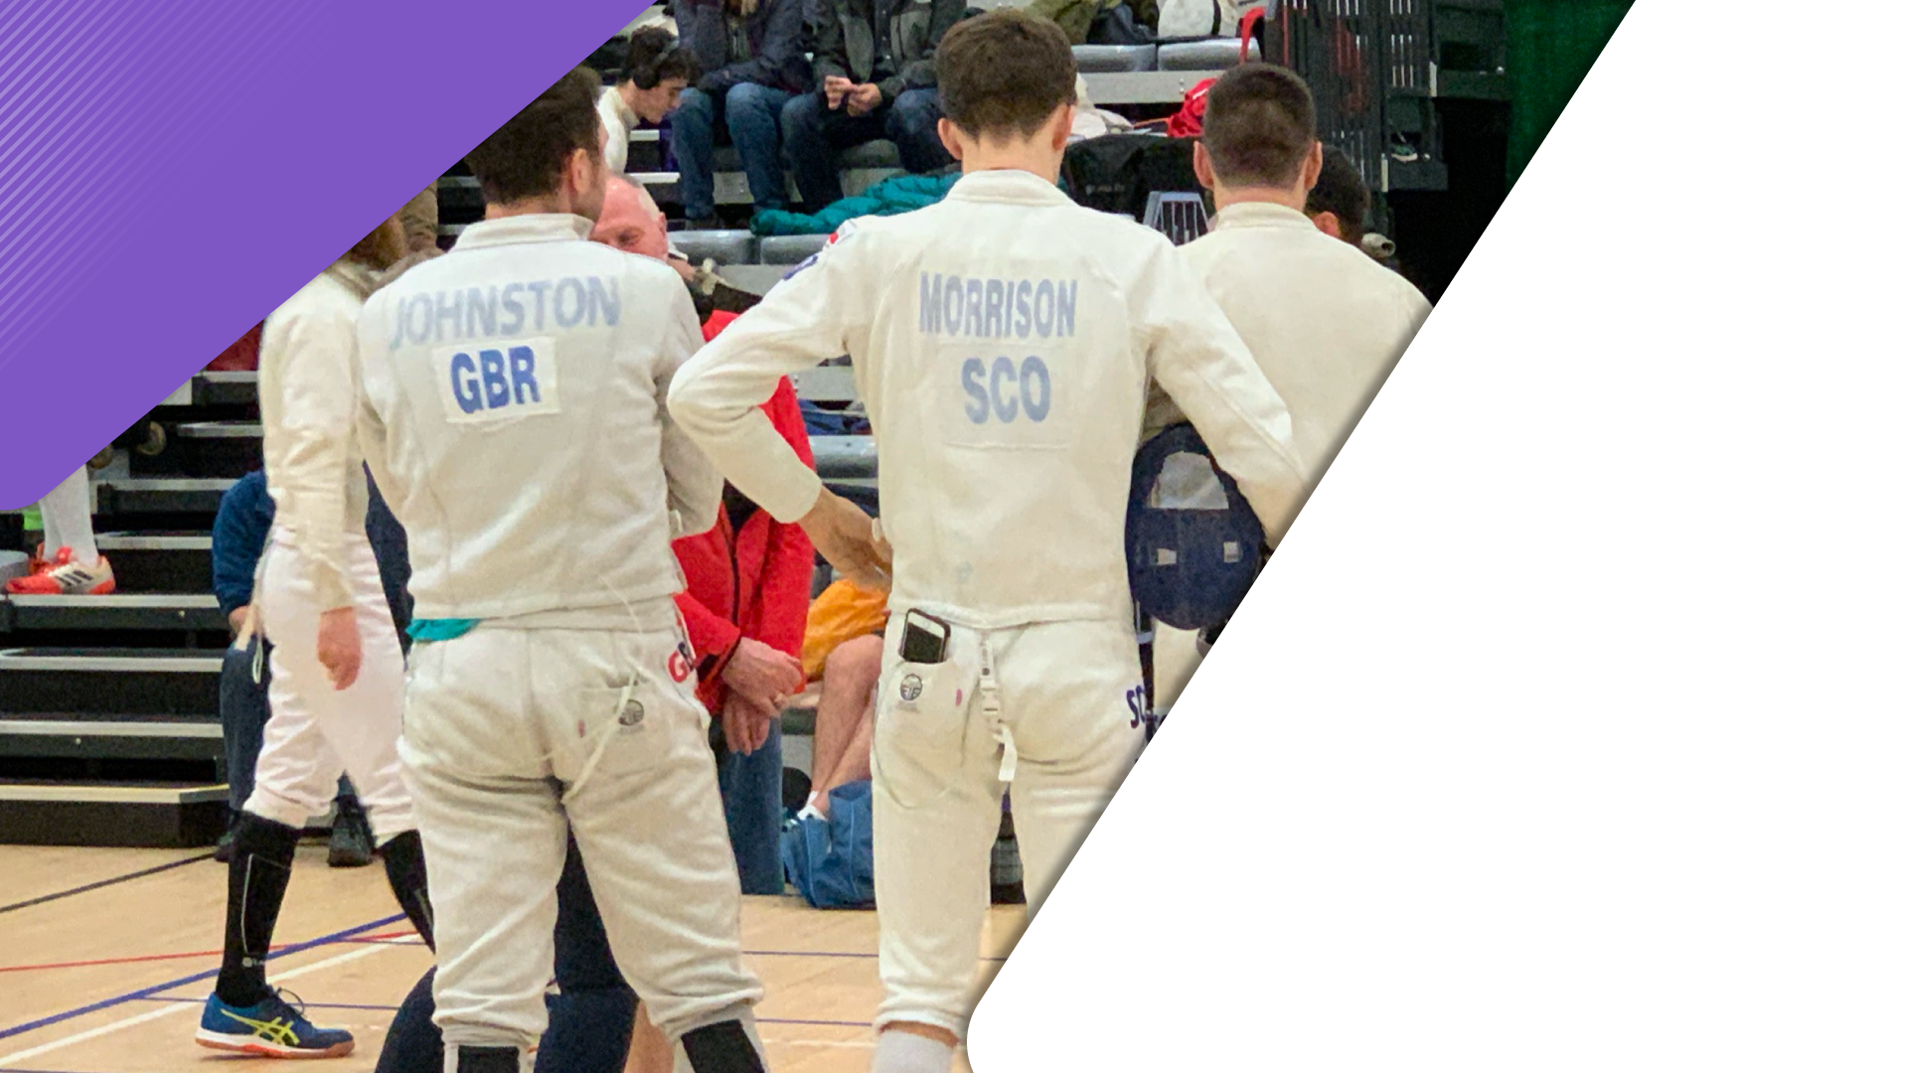
OUR STRATEGY | 2022-2025
www.scottish-fencing.com
#ForgingTheFuture

